Slide 1
English Language Resource Materials on
National Security Education at the Secondary Level
An Example of Learning and Teaching Activities
Food Security
Father of Hybrid Rice

Slide 2
Module | Unit | Topic
Wonderful Things | Successful People and Amazing Deeds | Father of Hybrid Rice
Content Objectives
To explore concepts related to food security, e.g.
the problem of food scarcity and the reasons behind
the contribution of Yuan Long-ping, a Chinese scientist, to addressing food insecurity
our role in safeguarding food security of our country
Language Objectives
To develop language knowledge and skills, e.g.
English Language
Education
Father of Hybrid Rice
National Security
Education
listening, speaking, reading/viewing and writing skills
text structures (e.g. infographic, video, article)
the use of the simple past tense and the present perfect tense
vocabulary building strategies (i.e. parts of speech, common affixation)

Slide 3
Pre-viewing
Find out how much students know about food security.
While-viewing
Play the video.
Post -viewing
Use the article on Yuan Long-ping as a follow-up to engage students in reflecting on what they have learnt from him and the importance of food security.
Engage students in finding out the benefits of hybrid rice and Yuan Long-ping’s contribution to addressing food insecurity.
Use infographics to introduce concepts related to food security.
Guide students to explore what they can do to safeguard food security in their daily life.
Guide students to develop the language knowledge and skills through integrating information and ideas from the video and the article on Yuan Long-ping.
A Video on
“The Father of Hybrid Rice”
Famous Scientist – Yuan Long-ping
Source: The Father of Hybrid Rice. LUI Che Woo Prize: https://youtu.be/tq22whjfZ4w

Slide 4
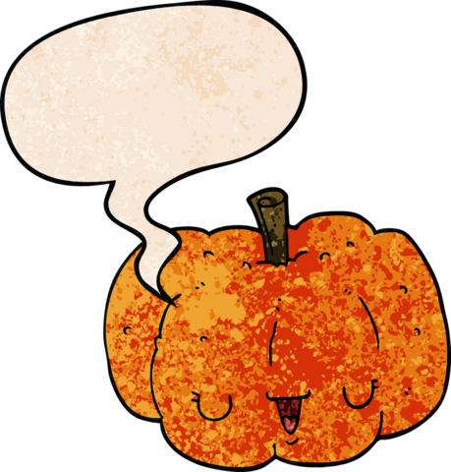
About Food Security…
Find out how much students know about food security.
Pre-viewing
How would your health be affected if you lived in a country with low food security?
Imagine not eating for a whole day. How would you feel?
What are the reasons contributing to food scarcity?
Why is safeguarding food security important to our country’s development?

Slide 5
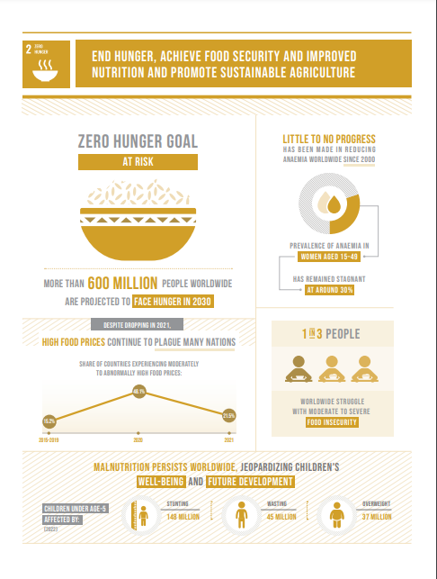
Background:
In 2015, the United Nations initiated the Sustainable Development Goals (SDGs) to address global challenges. Among a total of 17 SDGs, one of them was Zero Hunger Goal. Read the following infographic to find out more about this goal.
Use infographics to introduce concepts related to food security.
Pre-viewing
According to the information, which of the following is TRUE?
More than 600 million people are definitely not going to get enough food by 2030.
High food prices are a problem to many countries in 2021.
Only one third of the world’s population can obtain adequate food.
The problem of malnutrition affected around 230 million teenagers in 2022.
An Infographic on “Zero Hunger Goal”
Please click here to download the text.
Source: From The Sustainable Development Goals Report Special edition, edited by Jennifer Ross, ©2023 United Nations. Reprinted with the permission of the United Nations. https://www.un.org/sustainabledevelopment/wp-content/uploads/2023/08/2309739_E_SDG_2023_infographics-2-2.pdf

Slide 6
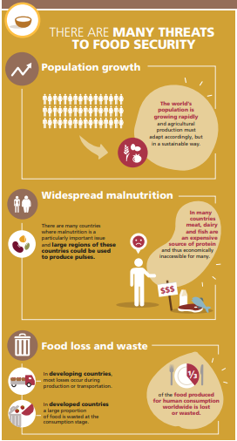
What factors contribute to food insecurity? Read the section “There are many threats to food security” of the following infographic to find out more.
Fill in each blank with ONE word taken from the infographic.
An Infographic on
“Pulses Contribute to Food Security”
There are a number of threats to food security. Apart from the rapid __________ in the world’s population, malnutrition is widespread in many countries as food source of protein such as meat and fish is __________. Moreover, a considerable amount of food is __________ before it is consumed in developing countries.
growth
expensive
wasted / lost
Please click here to download the text.
Source:
© FAO 2021 Infographic - Pulses Contribute to Food Security https://www.fao.org/3/c0063/C0063.pdf

Slide 7
Reflection on Food Security
2. Do you think factors such as technology and weather play a role in food security? Why?
1. Apart from the three major reasons mentioned in the infographic, what are some other factors that threaten food security?
3. How can we safeguard food security?
7

Slide 8
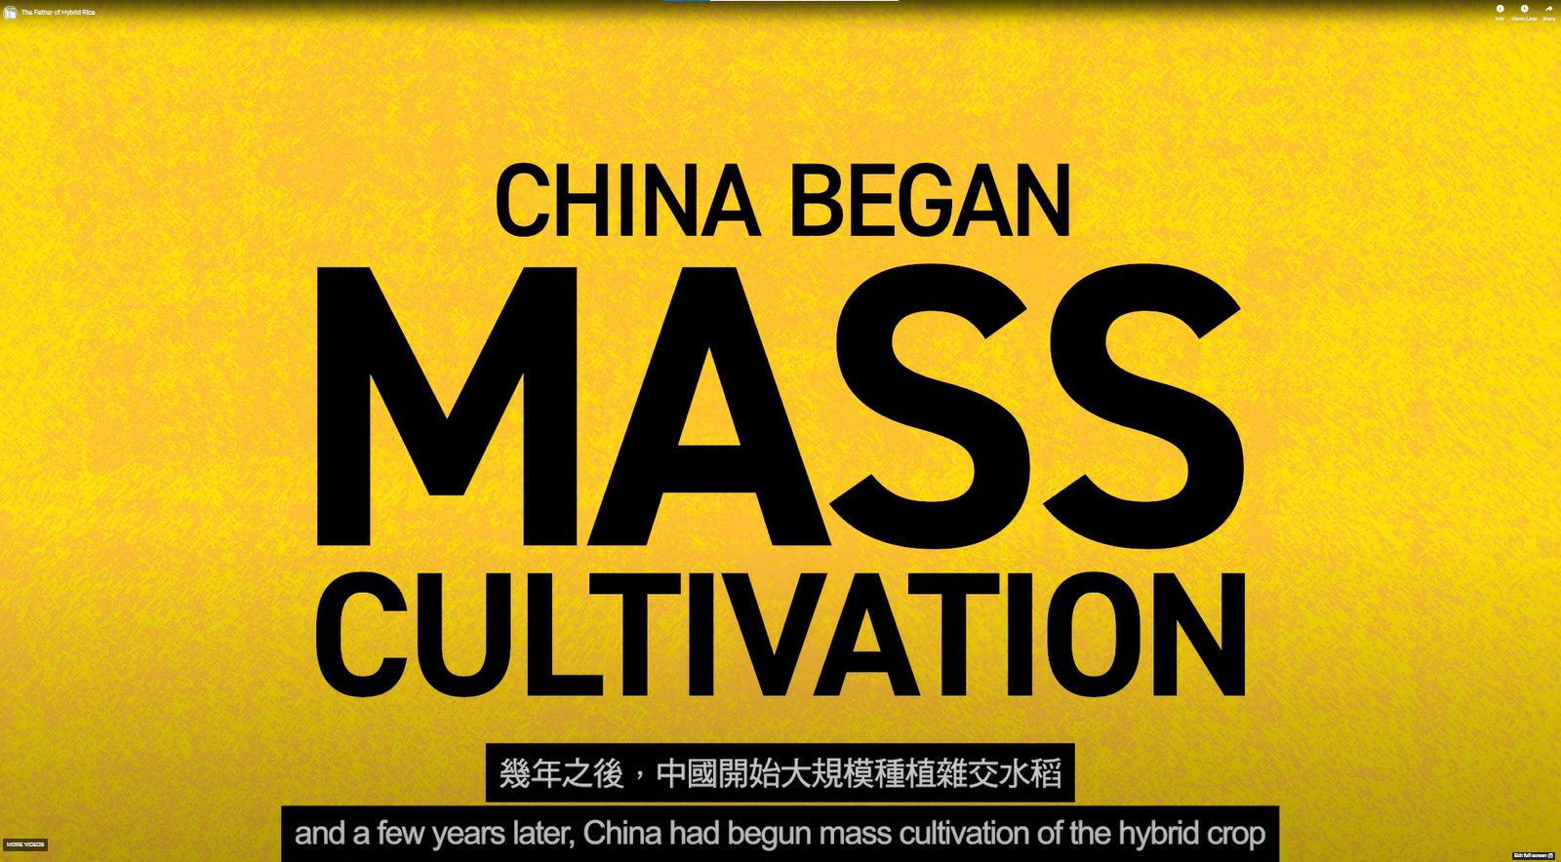
A Video on
“The Father of Hybrid Rice”
Play the video.
Engage students in finding out the benefits of hybrid rice and Yuan Long-ping’s contribution to addressing food insecurity.
While-viewing
Video Time: 00:00 – 00:27
Video Time: 00:28 – 01:03
Video Time: 01:04 – 01:47
Why is Yuan Long-ping called the father of hybrid rice?
What is hybrid rice?
Why is growing hybrid rice beneficial to our country in terms of food security?
What are Yuan Long-ping’s contribution to China and the world?
Source: The Father of Hybrid Rice LUI. Che Woo Prize: https://youtu.be/tq22whjfZ4w

Slide 9
A Video on
“The Father of Hybrid Rice”
What is the main idea of this part of the video?
To explain how tall hybrid rice can grow
To introduce Yuan Long-ping’s background and achievements
To explain why Yuen Long-ping is called the father of hybrid rice
To give details about the benefits of growing hybrid rice
Video Time: 00:00 – 00:27
Source: The Father of Hybrid Rice. LUI Che Woo Prize: https://youtu.be/tq22whjfZ4w

Slide 10
A Video on
“The Father of Hybrid Rice”
Fill in the following blank with ONE word taken from the video.
Video Time: 00:28 – 01:03
Many people in our country suffered from _________ in the early 1960s because there was not enough food.
famine
Source: The Father of Hybrid Rice. LUI Che Woo Prize: https://youtu.be/tq22whjfZ4w

Slide 11
A Video on
“The Father of Hybrid Rice”
Video Time: 00:28 – 01:03
What is hybrid rice?
It is a rice crossbred from two genetically distinct parents.
Source: The Father of Hybrid Rice. LUI Che Woo Prize: https://youtu.be/tq22whjfZ4w

Slide 12
A Video on
“The Father of Hybrid Rice”
According to the video, which of the following is NOT a benefit of growing hybrid rice to improve food security in our country?
Video Time: 00:28 – 01:03
It takes less time to mature.
It can produce greater yield.
It can withstand harsh conditions.
It is more nutritious than other rice.
Source: The Father of Hybrid Rice. LUI Che Woo Prize: https://youtu.be/tq22whjfZ4w

Slide 13
A Video on
“The Father of Hybrid Rice”
Which of the following sentences about Yuan Long-ping is NOT true?
His research results were only applied in China.
He was highly regarded internationally due to his research.
He taught other scientists the technology of growing hybrid rice.
His research improved food security of our country in fewer than 30 years.
Video Time: 01:04 – 01:47
Source: The Father of Hybrid Rice. LUI Che Woo Prize: https://youtu.be/tq22whjfZ4w

Slide 14
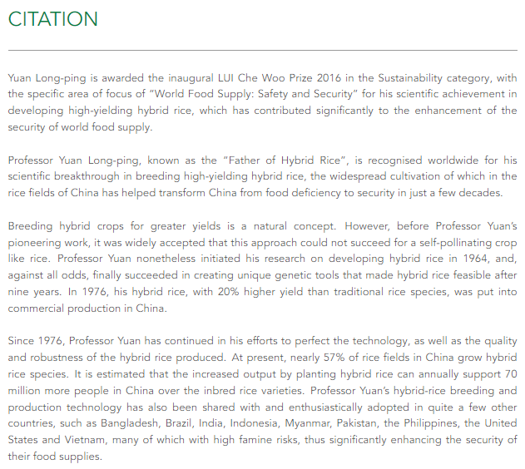
Use the article on Yuan Long-ping as a follow-up to engage students in learning more about his contribution to addressing food insecurity.
Post-viewing
Yuan Long-ping
Please click here to download the text.
Source (Text of the article)
Yuan Long-ping. LUI Che Woo Prize. Retrieved from: http://www.luiprize.org/652/

Slide 15
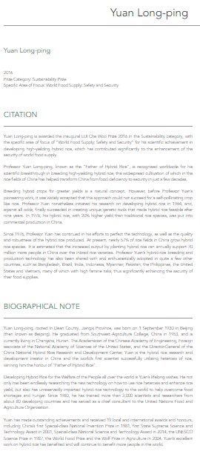
Complete the following timeline with reference to the video “The Father of Hybrid Rice” and the article on Yuan Long-ping.
______
Yuan’s hybrid rice was put into ______________ production in China.
1980
1981
Yuan was awarded China’s ______________ Special-class National Invention Prize.
1976
1964
Yuan initiated his ______________ on developing hybrid rice.
Yuan envisioned a super rice that could end hunger.
Yuan started to train ______________ and researchers from other countries.
1960s
Yuan graduated from Southwest Agriculture College, China.
_____
Yuan was born in Beijing.
1930
1953
research
commercial
A Video on
“The Father of
Hybrid Rice”
An Article on
Yuan Long-ping
scientists
Source: Yuan Long-ping. LUI Che Woo Prize: http://www.luiprize.org/652/
Source: The Father of Hybrid Rice.
LUI Che Woo Prize:
https://youtu.be/tq22whjfZ4w
first

Slide 16
Guide students to develop the language knowledge and skills through integrating information and ideas from the video and the article on Yuan Long-ping.
Post-viewing
Language Focus 1: Tenses
Guide students to identify and understand the use of the simple past tense and the present perfect tense in the video and the article to describe Yuan Long-ping’s contribution and achievements.
The simple past tense was used to describe past events:
e.g. As a budding scientist in China, he had an idea that hybrid rice might end hunger.
e.g. Yuan Long-ping generously shared his knowledge and technology with the world.
The present perfect tense was used to describe actions which started in the past and continue up to the present:
e.g. Professor Yuan’s hybrid-rice breeding and production technology has also been shared with and enthusiastically adopted in quite a few other countries.
e.g. Yuan’s excellent work on hybrid rice has benefited and will continue to benefit more people in the world.
A Video on
“The Father of Hybrid Rice”
An Article on
Yuan Long-ping
Source: The Father of Hybrid Rice.
LUI Che Woo Prize:
https://youtu.be/tq22whjfZ4w
Source: Yuan Long-ping. LUI Che Woo Prize: http://www.luiprize.org/652/

Slide 17
Language Focus 2: Parts of Speech
Guide students to develop their knowledge of lexical relations by highlighting the vocabulary and parts of speech.
research:
Yuan’s decades of research (n.) in the field and laboratories finally bore fruit in the early 70’s of the last century.
… he has trained more than 3,000 scientists and researchers (n.) …
success:
Even after his successes (n.) and global recognition for his scientific breakthroughs, Yuan remained the man working in the field.
… it was widely accepted that this approach could not succeed (v.) for a self-pollinating crop like rice.
… Yuan is … the world’s first scientist successfully (adv.) utilizing heterosis of rice …
A Video on
“The Father of Hybrid Rice”
An Article on
Yuan Long-ping
Source: The Father of Hybrid Rice.
LUI Che Woo Prize:
https://youtu.be/tq22whjfZ4w
Source: Yuan Long-ping. LUI Che Woo Prize: http://www.luiprize.org/652/

Slide 18
Language Focus 2: Parts of Speech
Guide students to develop their knowledge of lexical relations by highlighting the vocabulary and parts of speech.
recognise:
Even after his successes and global recognition (n.) for his scientific breakthroughs, Yuan remained the man working in the field.
Professor Yuan Long-ping … is recognised (v.) worldwide for his scientific breakthrough in breeding high-yielding hybrid rice …
science:
As a budding scientist (n.) in China, he had an idea that hybrid rice might end hunger.
Yuan Long-ping is awarded the inaugural LUI Che Woo Prize 2016 … for his scientific (adj.) achievement …
A Video on
“The Father of Hybrid Rice”
An Article on
Yuan Long-ping
Source: The Father of Hybrid Rice.
LUI Che Woo Prize:
https://youtu.be/tq22whjfZ4w
Source: Yuan Long-ping. LUI Che Woo Prize: http://www.luiprize.org/652/

Slide 19
Language Focus 3: Common Affixation
Guide students to develop their knowledge of word formation by highlighting some common affixation which will help students expand their vocabulary.
Nouns ending in -tion, -or and -tist:
-tion
It is a rice crossbred … which could … survive in tougher conditions.
-or
In 1976, his hybrid rice … was put into commercial production in China.
Professor Yuan Long-ping … is recognised worldwide …
… Yuan is the hybrid rice research and development creator in China …
-ment
Yuan Long-ping is awarded the inaugural Lui Che Woo Prize 2016 … for his scientific achievement in developing … which has contributed significantly to the enhancement of the security of world food supply.
A Video on
“The Father of Hybrid Rice”
An Article on
Yuan Long-ping
Source: The Father of Hybrid Rice.
LUI Che Woo Prize:
https://youtu.be/tq22whjfZ4w
Source: Yuan Long-ping. LUI Che Woo Prize: http://www.luiprize.org/652/

Slide 20
Language Focus 3: Common Affixation
Guide students to develop their knowledge of word formation by highlighting some common affixation which will help students expand their vocabulary.
Adjectives ending in -al and –able/-ible:
-al
In 1976, his hybrid rice, with 20% higher yield than traditional rice species, was put into commercial production in China.
-able -ible
It was a move that could feed a fifth of the world’s population, utilizing only 9% of the arable land.
Yuan has made outstanding achievements and received 19 local and international awards and honours …
Professor Yuan … finally succeeded in creating unique genetic tools that made hybrid rice feasible after nine years.
A Video on
“The Father of Hybrid Rice”
An Article on
Yuan Long-ping
Source: The Father of Hybrid Rice.
LUI Che Woo Prize:
https://youtu.be/tq22whjfZ4w
Source: Yuan Long-ping. LUI Che Woo Prize: http://www.luiprize.org/652/

Slide 21
Language Focus 3: Common Affixation
Guide students to develop their knowledge of word formation by highlighting some common affixation which will help students expand their vocabulary.
Adverbs ending in -ly:
-ly
It is a rice crossbred from two genetically distinct parents …
He not only has been endlessly researching the new technology on how to use rice heterosis and enhance rice yield, but also has unreservedly imparted hybrid rice technology to the world to help overcome food shortages and hunger.
A Video on
“The Father of Hybrid Rice”
An Article on
Yuan Long-ping
Source: The Father of Hybrid Rice.
LUI Che Woo Prize:
https://youtu.be/tq22whjfZ4w
Source: Yuan Long-ping. LUI Che Woo Prize: http://www.luiprize.org/652/

Slide 22
Reflection on Food Security
2. What have you learnt from Yuan Long-ping, the father of hybrid rice?
1. How has Yuan Long-ping’s scientific breakthrough improved food security of our country and the world?
3. Apart from scientists, who do you think are responsible for solving the problem of food scarcity?
4. What are other ways to safeguard food security?
22

Slide 23
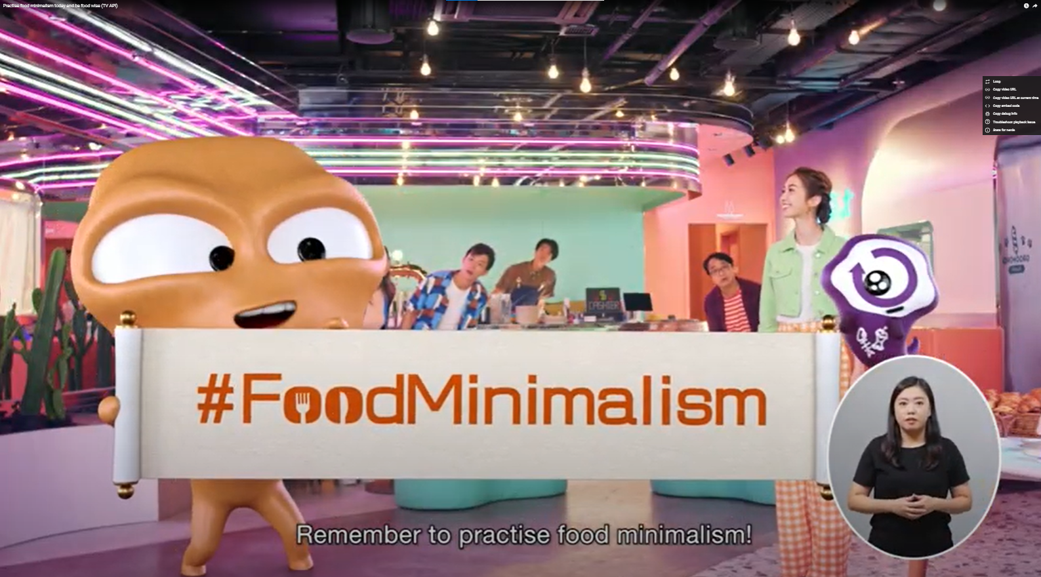
Guide students to explore what they can do to safeguard food security in their daily life.
What can we do to cope with the problem of food insecurity or food shortage? Discuss with your classmates and watch the following video to learn more.
Post-viewing
Devise a 7-day Food-saving Challenge for your friends and family as well as yourself to reduce food waste.
A Video on
“Practise food minimalism today and be food wise”
7-day Food-saving Challenge
Day 1 | Finish my plate at every meal.
Day 2 | Order only portions I can finish when dining out.
Day 3 | Take stock of food at home and consume food that is soon to expire first.
Day 4 | …
… | …
Please click here to view the video.
Source: Practise food minimalism today and be food wise. (14 October 2022). Environmental Protection Department, HKSAR Government.
https://www.youtube.com/watch?v=bWDFATiiIrE

Slide 24
Extended Learning Activities
Arrange a tour to Feeding Hong Kong, a charitable organisation that redistributes surplus food collected from companies to local charities, so as to help students explore the issue of food security.
Invite students to give a presentation / design a poster / create a video to call for action on food wastage.
Information on an educational visit to Feeding Hong Kong:
https://feedinghk.org/schools/

